Slide 1

REACT

Slide 2
A (very) Brief History
Created in 2013 by Jordan Walk,
Maintained by Facebook and the community as a whole
One of FaceBook’s first open-source projects

Slide 3


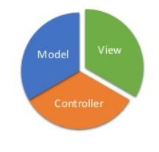
What is React?
React is a JavaScript library for building fast and interactive user interfaces for the web as well as mobile applications.
It is an open -source, reusable component - based front end library
In a model view controller architecture, React is the "View" which is responsible for how the app looks and feels.
React is a combination of HTML (Hypertext Markup Language), CSS (Cascading Style Sheets), and JavaScript. CSS is used only for styling the webpage or application

Slide 4
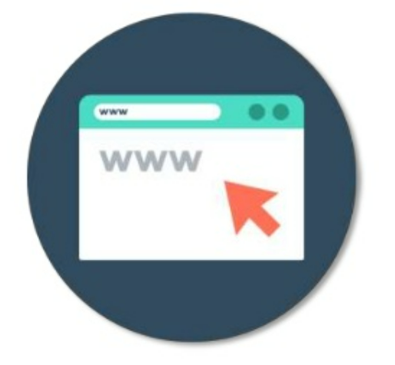
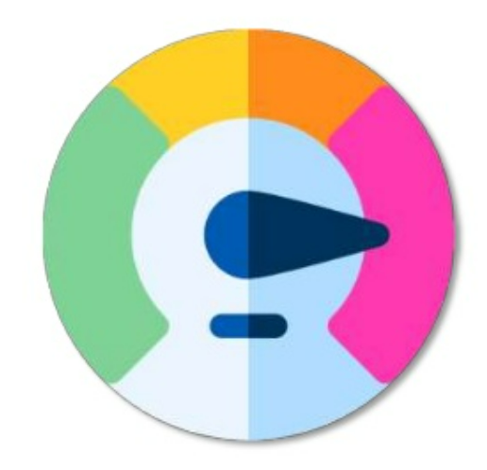

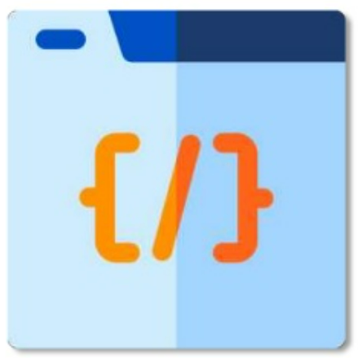
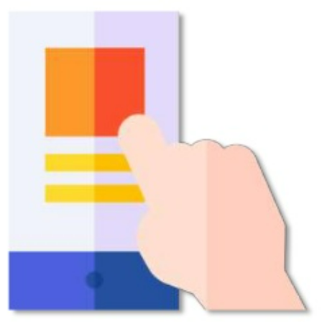
Why Should You Use React?
Easy creation of dynamic web applications
Can also be used for mobile apps
Reusable components
Dedicated debugging tools
Most popular front-end library by a wide margin (Check this Out!)

Slide 5
Features of React
JSX - JavaScript Syntax Extension
Virtual DOM
Performance
Debugging

Slide 6
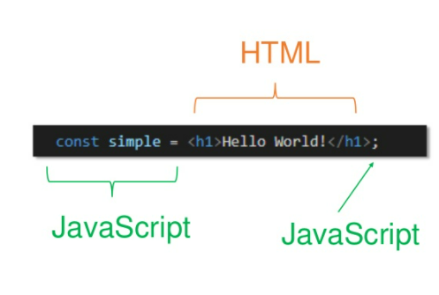
JS with HTML
Normally in frontend-related projects, we keep HTML, CSS, and JavaScript code in separate files. However in React, this works a bit differently.
JSX is a special syntax extension to JS for React
In React projects, we don't create separate HTML files, because JSX allows us to write HTML and JavaScript combined together in the same file. You can, however, separate your CSS in another file.

Slide 7

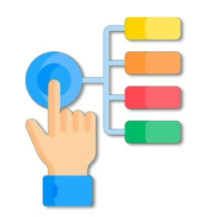

How does React work?
Document Object Model (DOM)
Performance
Document Object Model connects programming languages or script to web pages by representing the structure of a document - such as the HTML representing a web page in memory
The DOM represents a document with a logical tree. Each branch of the tree ends in a node and each node contains objects.
React keeps a lightweight representation of the Real DOM in memory, and that is known as the Virtual DOM
React uses Virtual DOM that makes web apps fast.
Complex User Interface is broken down into individual components allowing multiple users to work on each component simultaneously.

Slide 8

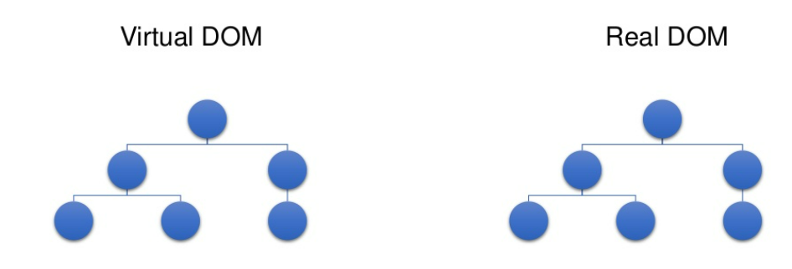

How does React Work?
React creates a virtual DOM in memory
Notice that the virtual DOM is the exact copy of the real DOM
Instead of manipulating the browser's DOM directly, React creates a virtual DOM, where it does all the necessary manipulations, before making the changes in the browser DOM.
When the state of an object changes, Virtual DOM changes only that object in the real DOM instead of updating all the objects

Slide 9
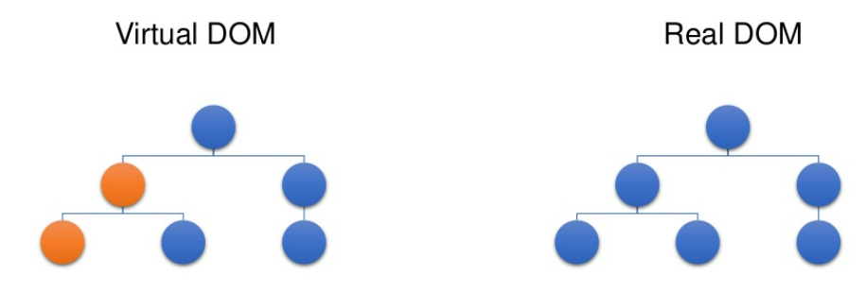
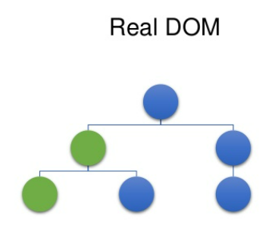
Virtual DOM is compared to its previous state and then React gets to know which objects have changed
Only the changed objects get updated in the Real DOM
The states of these objects have changed

Slide 10
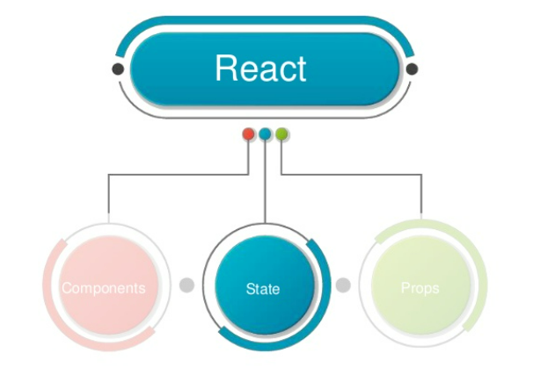
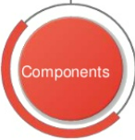
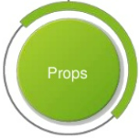
Components, State & Props

Slide 11
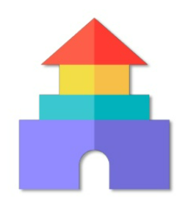
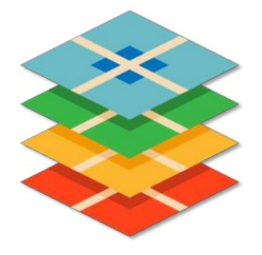

What are Components?
Components are the building blocks of any React application, and a single app usually consists of multiple components.
A component is essentially a piece of the User Interface. It is like a function that returns HTML elements.
It splits the User Interface into independent, reusable pieces that can be processed separately.
React has two types of components: Class & Function Components

Slide 12

Search Component
React divides the UI into multiple components, which makes the code easier to debug, and each component has its own property and function.
Take an example of an Instagram webpage which is entirely built using React
Let's see how React works in real-time
Profile Description Component
Stories Component
Posts List Component
Single Post Component

Slide 13
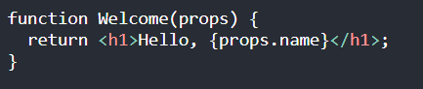
Function Component
Class Component
A functional component is basically a JavaScript function that returns a React element.
Always starts with a capital letter (naming convention)
Takes props as a parameter if necessary
Class components are classes that use render method to return a react element.
The class will be a component once it ‘extends’ a React component.
It takes Props in the constructor if needed (Which we will discuss in the next few slides);

Slide 14
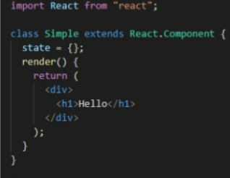
Let's take an Example!
Components are independent and reusable bits of code. They serve the same purpose as JavaScript functions, but work in isolation and return HTML via a render() method.
A component is implemented as a JavaScript class having some state and a render method.
State is the data we want the component to render
Render method is responsible for how the User Interface looks and feels to the user

Slide 15
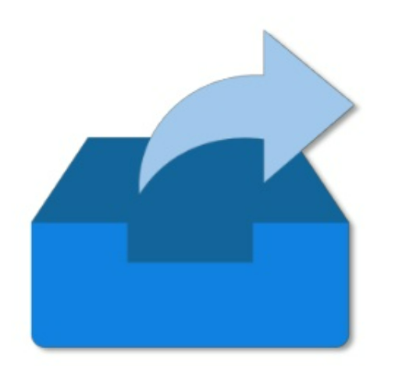
What are Props?
Stands for Properties
React Props are like function arguments in JavaScript and attributes in HTML.
They are used to pass data between React components. But, can be used in a unidirectional flow (parent => child)
Props are a generic object type used by Components to use passed object properties.

Slide 16
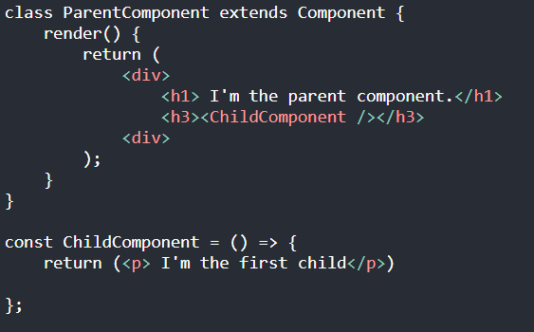
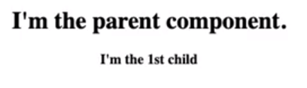
Example
This is how we call a component in a parent class. It is in an HTML tag but it must start with a capital letter.
Output:

Slide 17
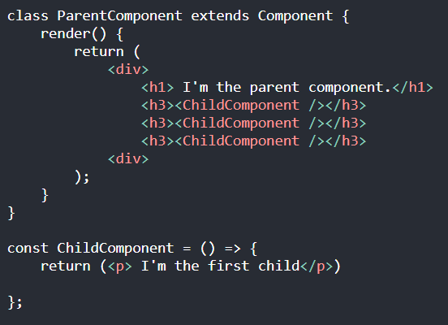
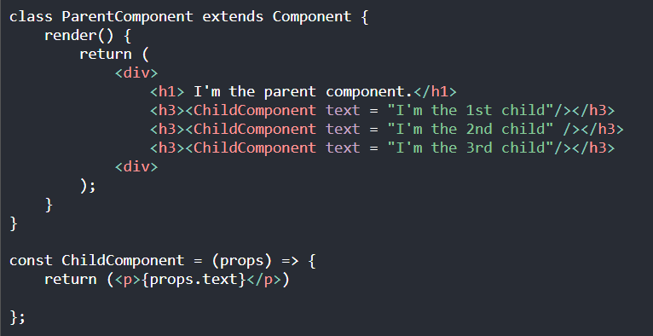
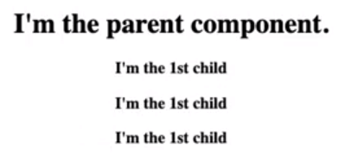
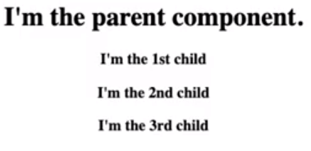
Without props:
With props:
Output:
Output:
Syntax: <Component property = "value"/>

Slide 18
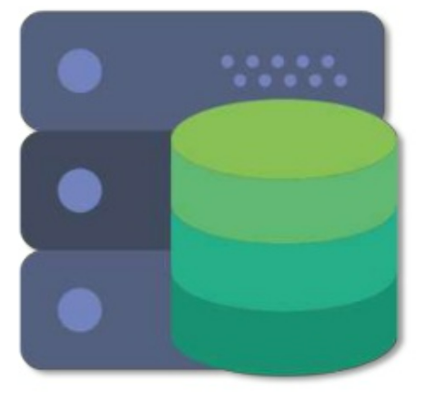

What is a State?
React has another special built-in object called state, which allows components to create and manage their own data.
So unlike props, components cannot pass data with state, but they can create and manage it internally.

Slide 19
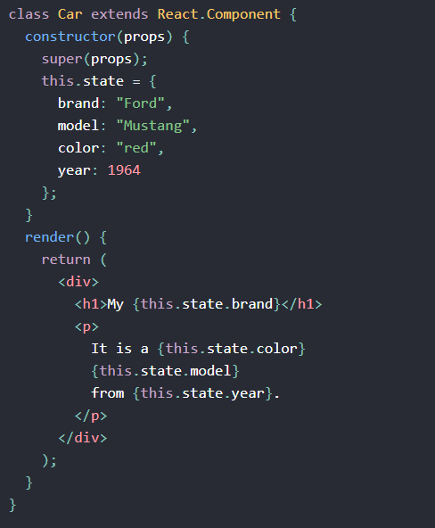
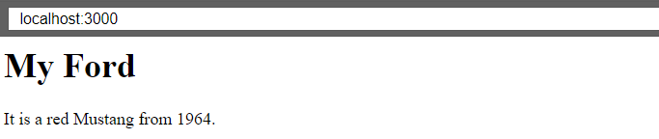
Example
State holds the data that a component renders on the web application
Refer to the state object anywhere in the component by using the this.state.propertyname syntax:
Output:

Slide 20
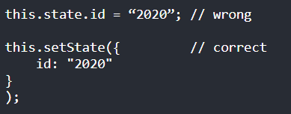
Updating a Component's State
State should not be modified directly, but it can be modified with a special method called setState( ).

Slide 21
What happens when state changes?
A change in the state happens based on user-input, triggering an event, and so on.
React components (with state) are rendered based on the data in the state. State holds the initial information.
So when state changes, React gets informed and immediately re-renders the DOM – not the whole DOM, but only the component with the updated state. This is one of the reasons why React is fast.
The setState( ) method triggers the re-rendering process for the updated parts. React gets informed, knows which part(s) to change, and does it quickly without re-rendering the whole DOM.

Slide 22
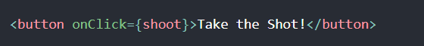
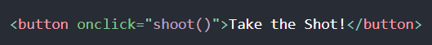
Events
React can perform actions based on user events.
React has some of the following events, similar to HTML: click, change, mouseover, etc….
React event handlers are written inside curly braces
React:
HTML:

Slide 23
THANK
YOU!!!
Time for Demo

Slide 24


